Slide 1
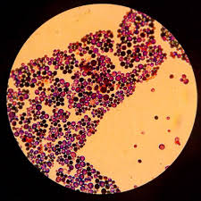
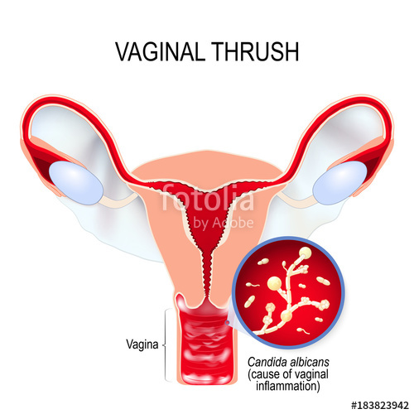
Recurrent Vulvovaginal Candidiasis
Distressing but treatable fungal infection

Slide 2
Recurrent Vulvovaginal Candidiasis (RVVC) - Definition
Recurrent Vulvovalginal Candidiasis (RVVC), usually defined as four or more episodes of symptomatic VVC within 1 year, or at least three episodes unrelated to antibiotic therapy occur within one year.
Recurrent vulvovaginal candidiasis (VVC) is a difficult-to-manage condition
Treatment is indicated for relief of symptoms. Ten to 20 percent of reproductive-age women who harbor Candida species are asymptomatic; these women do not require therapy

Slide 3
Recurrent Vulvovaginal Candidiasis
The disorder is uncommon in postmenopausal women unless they are taking estrogen therapy
Recurrent disease is usually due to relapse from a persistent vaginal reservoir of organisms or endogenous reinfection with identical strains of susceptible C. albicans however, rarely, a new strain of Candida is responsible for the infection.

Slide 4
Prevalence of recurrent vulvovaginal candidiasis
372 million women are affected by recurrent vulvovaginal candidiasis over their lifetime.
The 25–34 year age group has the highest prevalence (9%)
75% of women will experience an episode of vulvovaginal candidiasis in their lifetimes
50% of initially infected women will experience at least a second episode
5-10% of all women experience recurrent vulvovaginal candidiasis
(>4 episodes /year)
Recurrent VVC occurs in 5% of healthy woman
Recurrent VVC frustrates both the patient and the doctor.
Not a cause of mortality but the morbidity associated with it makes it a major cause of mental distress

Slide 5
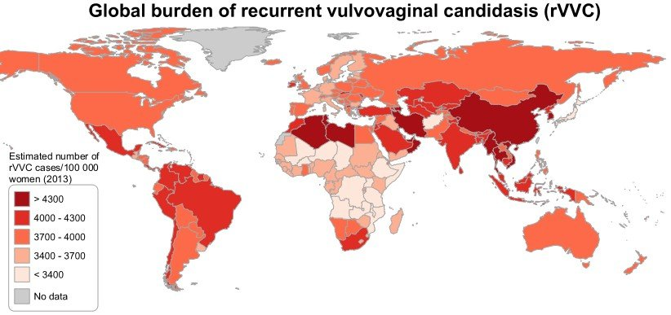
Prevalence of recurrent vulvovaginal candidiasis (lancet-infect-dis 2018)
138 million women suffer from recurrent thrush & is set to rise to an estimated 158 million people by 2030

Slide 6
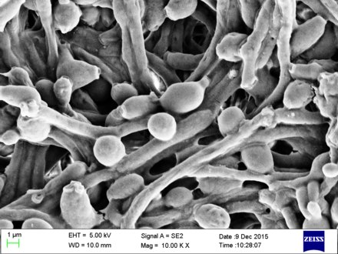
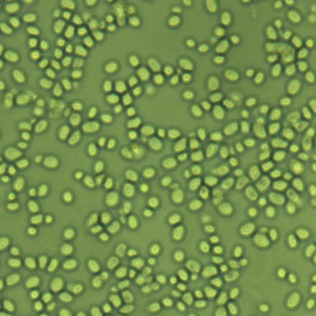
Aetiology
There are 150 Candida species
Most common is Candida albicans which accounts for 80-90%
Candida glabrata is the second most common and accounts for 5-15%
Candida tropicalis accounts for 5%
Other species like Candida krusei and Candida guilliermondi are rare
C.albicans
C.glabrata
C.krusei
C.tropicalis

Slide 7
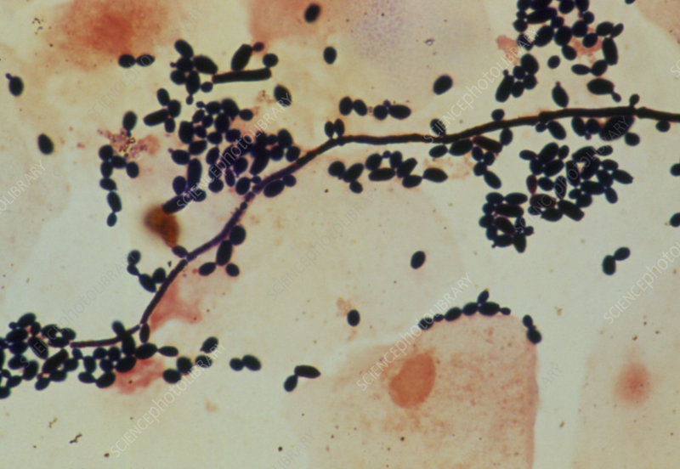
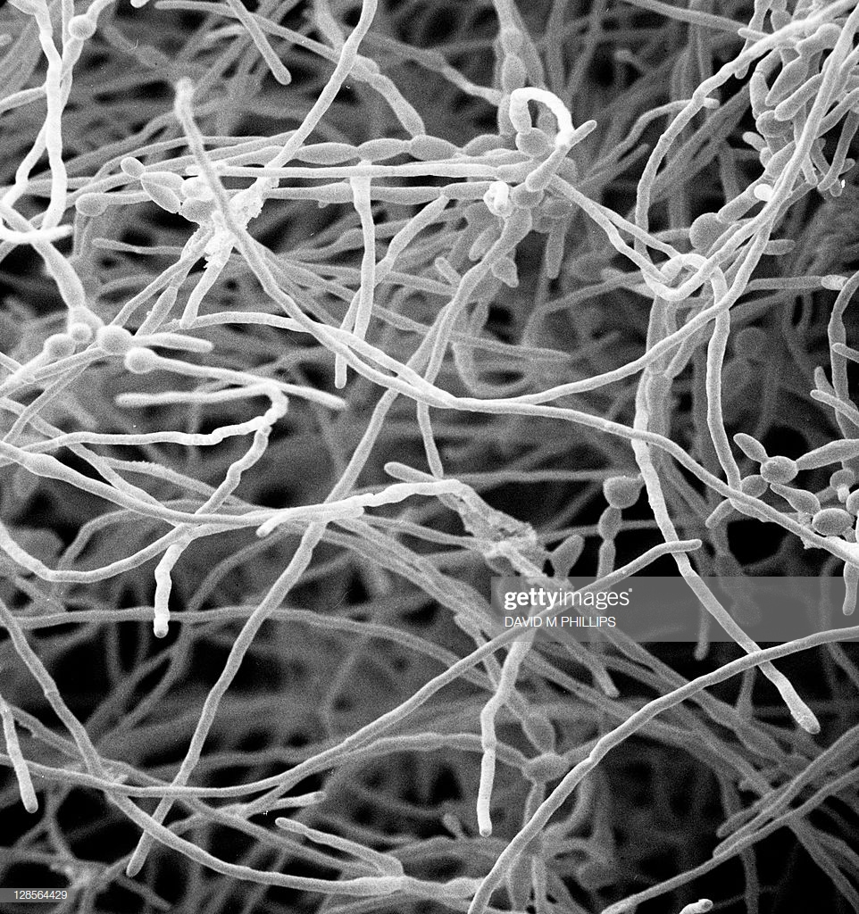
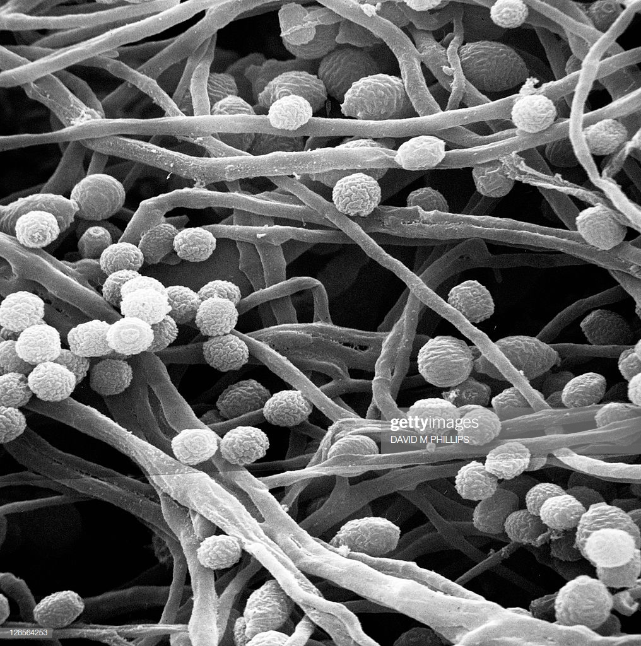
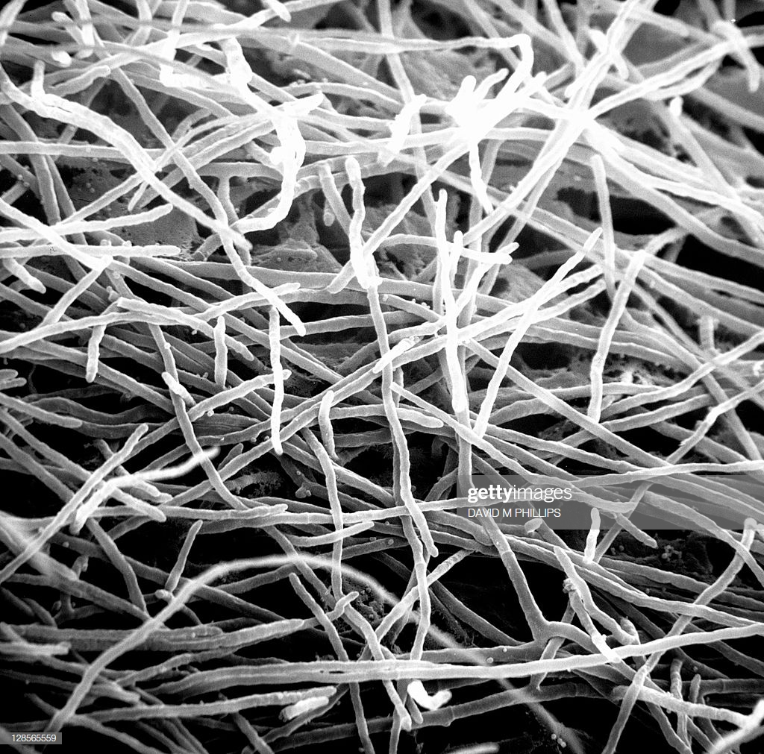
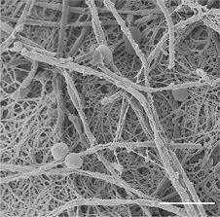
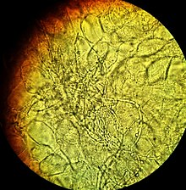
Vulvovaginal Candidiasis
Micrographs of candida infections of vagina

Slide 8
Possible risk factors for recurrent vulvovaginitis
Candida species,-Antifungal resistance can cause recurrent vulvovaginal candidiasis
Antibiotics Frequent antibiotic use decreases protective vaginal flora and allows colonization by Candida species.
Diabetes mellitus - predisposing factor
Increased estrogen levels – Vulvovaginal candidiasis appears to occur more often in the setting of increased estrogen levels, such as oral contraceptive use, pregnancy, and estrogen therapy.
Immunodeficiency
Mechanical irritation of vulvovaginal area
Inadequate treatment
Sexual transmission-Traditionally not considered as STD,BUT sexual transmission of Candida does occur
Recurrent vulvovaginal candidiasis may be due to deficient cell-mediated immunity

Slide 9
PATHOPHYSIOLOGY
RVVC is idiopathic in its origin.
Women with RVVC mount a strong inflammatory response when exposed to small amounts of Candida, whereas normal women may not mount any inflammatory response and remain asymptomatic.
Recurrent vulvovaginal candidiasis has also been associated with decreased in vivo concentration of mannose binding lectin (MBL) and increased concentration of IL-4. Two specific gene polymorphisms, variants in the MBL and IL-4 alleles, can account for this finding in some women.

Slide 10
Diagnosis of Recurrent Vulvovaginal Candidiasis
Predominant symptoms of vulvovaginal candidiasis include
Intense vulva pruritus, and abnormal vaginal discharge (which may be minimal, a thick “curd-like” material, or a watery secretion).
The vulva may be erythematous, edematous, and contain satellite lesions
There may be burning sensation with urination.
Rarely is vulva candidiasis seen without concomitant vaginal candidiasis
Diagnosis of vulvovaginal candidiasis can be made with patient’s history, clinical examination, supported by laboratory test of normal vaginal pH and yeast identified microscopically
In patients with recurrent vulvovaginal candidiasis, culture should always be obtained to exclude resistant organism
.

Slide 11
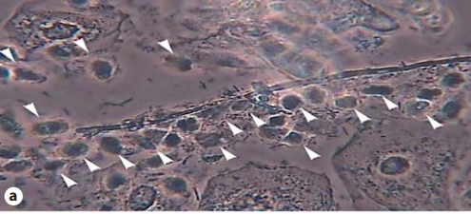
Diagnosis of Recurrent Vulvovaginal Candidiasis
Microscopy
Candida causing VVC can be diagnosed by scraping vulvar skin and/or vagina and examination by microscopy
Of importance are typical budding and branching pseudohyphae (pseudo-mycelium) are to be considered definite proof of Candida
Pseudo-mycelium forming C. albicans infection associated with a normal lactobacillary flora (pH = 4.5) and heavy leukocytosis reaction (white arrowheads)

Slide 12
Diagnosis of Recurrent Vulvovaginal Candidiasis
Culture
If Candida was detected during clinical examination and microscopy, there is usually no need for culture, except when you suspect non- albicans Candida may be present
The swab can be transported in a common Amies or Stuart transport medium as used for bacterial cultures, at room temperature and to be preferably plated at 6 h or less after sampling due to an increased risk of bacterial overgrowth
A vaginal sample is obtained from the lateral wall using a cotton-tipped swab and inoculated onto Sabouraud agar, Nickerson medium, or Microstix-Candida mediumSabouraud agar
Gilbert G.G. Donders a–d Gert Bellen a Werner Mendling e Management of Recurrent Vulvo-Vaginal Candidosis Gynecol Obstet Invest 2010;70:234–249

Slide 13
DIFFERENTIAL DIAGNOSIS OF VULVOVAGINITIS
Women with normal vaginal pH – hypersensitivity reactions, allergic or chemical reactions, contact dermatitis, and inflammatory dermatoses (eg, lichen sclerosus and lichen planus)mechanical irritation due to insufficient lubrication during coitus can also result in vaginal discomfort.
●
Women with elevated vaginal pH – If vaginal pH exceeds 4.5 or excess white cells are present, mixed infection with bacterial vaginosis or trichomoniasis may be present.
Mixed infection (≥2 pathogens and all are symptomatic) is estimated to occur in <5 percent of patients;
coinfection (≥2 pathogens but some are not symptomatic) is more common: 20 to 30 percent of women with bacterial vaginosis are coinfected with Candida species

Slide 14
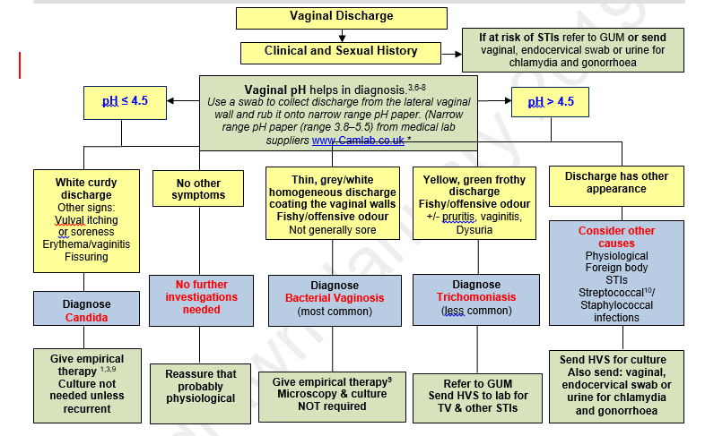
DIAGNOSIS OF VAGINAL DISCHARGE IN PATIENTS > 25 YEARS USING SYMPTOMS & SIGNS – PUBLIC HEALTH ENGLAND

Slide 15
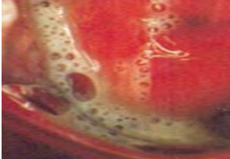
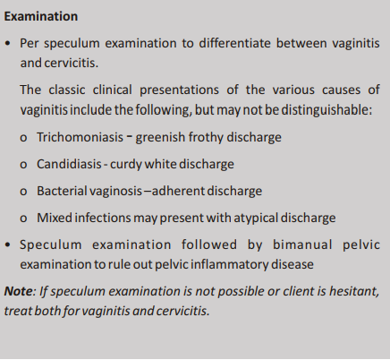
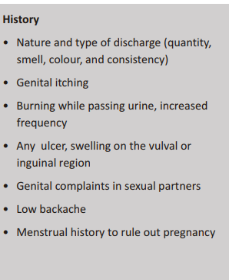
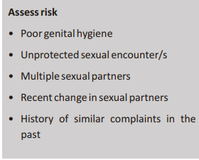
Ministry of Health and Family Welfare Government of India August 2014 Guidelines for Vaginitis
Frothy vagina

Slide 16
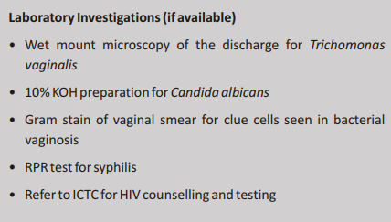
Ministry of Health and Family Welfare Government of India August 2014 Guidelines for Vaginitis (contd.)

Slide 17
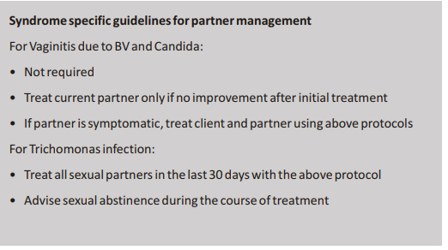
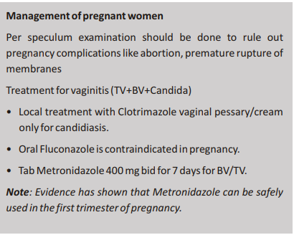
Ministry of Health and Family Welfare Government of India August 2014 Guidelines for Vaginitis (contd.)

Slide 18
Ministry of Health and Family Welfare Government of India August 2014 Guidelines for Vaginitis (contd.)

Slide 19
Before Therapy
Before proceeding with empiric antifungal therapy, the diagnosis should be confirmed by a wet-mount preparation with use of saline and 10% potassium hydroxide to demonstrate the presence of yeast or hyphae and a normal pH (4.0–4.5)
For those with negative findings, vaginal cultures for Candida should be obtained
CID 2016:62 (15 February)

Slide 20
Treatment of Recurrent Vulvovaginal Candidiasis
In women with acute, sporadic infections, short-term medical treatment with any antifungal medication is usually sufficient to cure the disease
Many women even clear their infection spontaneously if the predisposing factor has been eradicated or disappears (e.g. intake of antibiotics).
In recurrent disease, both proper diagnosis and definite cure are more difficult to achieve
Women suffering from RVVC require a different approach and need to be managed by installing a long-term suppressive medical therapy and by recognizing and eliminating predisposing factors that trigger the occurrence of recurrences or intensify their severity

Slide 21
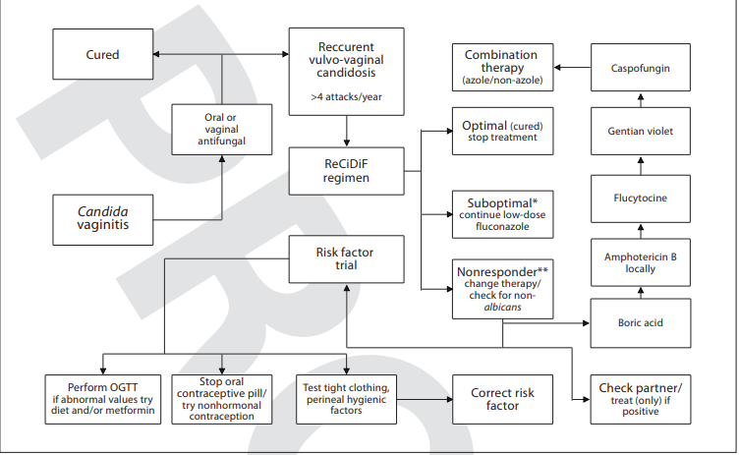
Treatment of Recurrent Vulvovaginal Candidiasis
Gilbert G.G. Donders a–d Gert Bellen a Werner Mendling e Management of Recurrent Vulvo-Vaginal Candidosis Gynecol Obstet Invest 2010;70:234–249

Slide 22
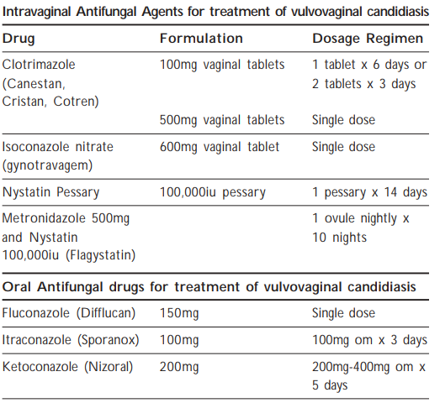
Treatment of Recurrent Vulvovaginitis
Liver function test monitoring is needed
. A study reviewed the effectiveness of one day intermittent monthly prophylaxis
with 400mg itraconaozle
It was a randomised study involving 57 patient and 57 controls.
Results showed monthly
itraconazole prophylaxis reduced the rate of recurrence, 36.4% (treatment group) vs. 64.5% (placebo group).
After one year, only 38.9% of patients in the treatment group and 28.8% in the placebo group had no recurrence of
symptoms.
If recurrence of symptoms occurs then the maintenance regimen should be kept for 12 months
MANAGEMENT OF RECURRENT VULVOVAGINAL CANDIDIASIS
Dr Ng Lai Peng Australian family physician · March 2011

Slide 23
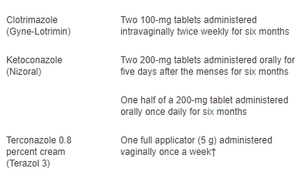
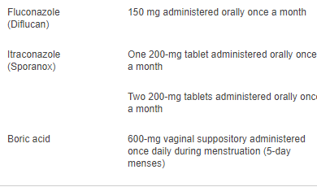
Prophylaxis of Recurrent Vulvovaginitis
Treatment of Recurrent Vulvovaginal Candidiasis: ERIKA N. RINGDAHL, M.D., University of Missouri–Columbia School of Medicine, Columbia, Missouri Am Fam Physician. 2000 Jun 1;61(11):3306-3312

Slide 24
Treatment in case of fungal resistance CDC Recommendations 2015
Fluconazole is well established as a first-line management option for the treatment and prophylaxis of localized and systemic C. albicans infections
Predictable pharmacokinetics and is effective, well tolerated
Safe in children, elderly and those with impaired immunity
However increasing use of fluconazole has led to emergence of resistance
Second-line therapy with a wider spectrum antifungal, such as itraconazole, should be sought if treatment with fluconazole fails

Slide 25
Dosage of Itraconazole capsules CDC Recommendations 2015
indication | Dosage Regimen
Vulvo-vaginal candidosis | 200 mg bd for 1 day
Recurrent vulvovaginal candidiasis | 200 mg, once monthly for six months
Capsules must be swallowed whole immediately after food.

Slide 26
Future Implications (PLOS ONE | www.plosone.org 2013 | Volume 8 | Issue 9 | e74378)
Vaginitis is often considered a minor and common vaginal condition by clinicians
The recurrent nature and the substantial impact vaginitis can have on women’s emotional, sexual and social lives means that women’s experiences can extend far beyond the physical symptoms
Recognition of psychosocial sequelae should be applied to any recurring vaginal condition that may be socially stigmatized and have symptoms which can cause great distress to women, impacting heavily on their quality of life.

